Slide 1

Introduction:
  Basic Concepts and Notations
  Complexity analysis: time space tradeoff
  Algorithmic notations, Big O notation
  Introduction to omega, theta and little o notation

Slide 2
Basic Concepts and Notations
Algorithm: Outline, the essence of a computational procedure, step-by-step instructions
Program: an implementation of an algorithm in some programming language
Data Structure: Organization of data needed to solve the problem

Slide 3
Algorithmic Problem
Specification of input
Specification of output as a function of input
?
Infinite number of input instances satisfying the specification. For example: A sorted, non-decreasing sequence of natural numbers of non-zero, finite length:
  1, 20, 908, 909, 100000, 1000000000.
  3.

Slide 4
Algorithmic Solution
Specification of input
Specification of output as a function of input
Algorithm
Algorithm describes actions on the input instance
Infinitely many correct algorithms for the same algorithmic problem

Slide 5
What is a Good Algorithm?
Efficient:
  Running time
  Space used
Efficiency as a function of input size:
  The number of bits in an input number
  Number of data elements(numbers, points)

Slide 6
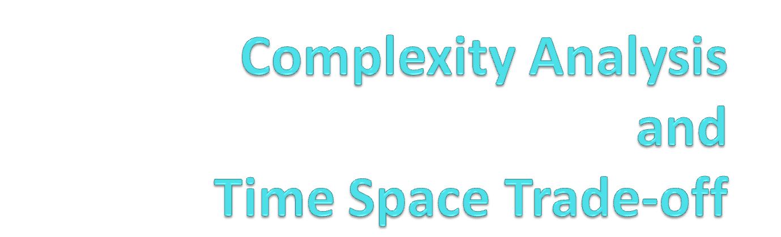

Slide 7
Complexity
A measure of the performance of an algorithm
An algorithm’s performance depends on
  internal factors
  external factors

Slide 8
External Factors
Speed of the computer on which it is run
Quality of the compiler
Size of the input to the algorithm

Slide 9
Internal Factor
The algorithm’s efficiency, in terms of:
Time required to run
Space (memory storage)required to run
Note:
Complexity measures the internal factors (usually more interested in time than space)

Slide 10
Two ways of finding complexity
Experimental study
Theoretical Analysis

Slide 11
Experimental study
Write a program implementing the algorithm
Run the program with inputs of varying size and composition
Get an accurate measure of the actual running time
Use a method like System.currentTimeMillis()
Plot the results

Slide 12
Example
a. Sum=0;
for(i=0;i<N;i++)
for(j=0;j<i;j++)
Sum++;

Slide 13
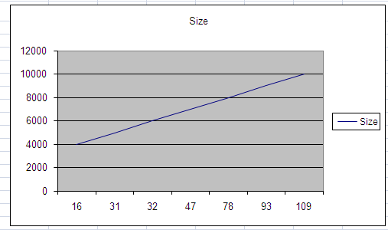
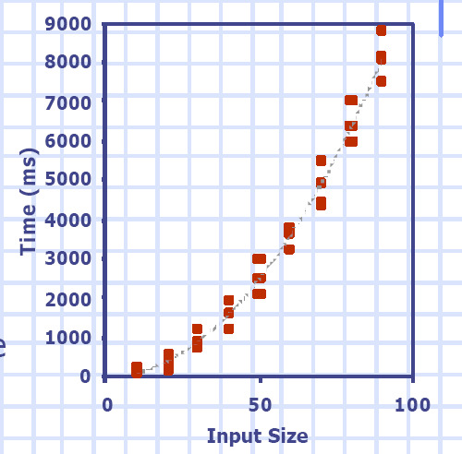

Example graph
Time in millisec

Slide 14
Limitations of Experiments
It is necessary to implement the algorithm, which may be difficult
Results may not be indicative of the running time on other inputs not included in the experiment.
In order to compare two algorithms, the same hardware and software environments must be used
Experimental data though important is not sufficient

Slide 15
Theoretical Analysis
Uses a high-level description of the algorithm instead of an implementation
Characterizes running time as a function of the input size, n.
Takes into account all possible inputs
Allows us to evaluate the speed of an algorithm independent of the hardware/software environment

Slide 16
Complexity analysis
Why we should analyze algorithms?
  Predict the resources that the algorithm requires
    Computational time (CPU consumption)
    Memory space (RAM consumption)
    Communication bandwidth consumption
  The running time of an algorithm is:
    The total number of primitive operations executed (machine independent steps)
    Also known as algorithm complexity

Slide 17
Need for analysis : Internal Factors
To determine resource consumption
  CPU time
  Memory space
Compare different methods for solving the same problem before actually implementing them and running the programs.
To find an efficient algorithm

Slide 18
Space Complexity
The space needed by an algorithm is the sum of a fixed part and a variable part
The fixed part includes space for
  Instructions
  Simple variables
  Fixed size component variables
  Space for constants
  Etc..

Slide 19
Cont…
The variable part includes space for
  Component variables whose size is dependant on the particular problem instance being solved
  Recursion stack space
  Etc..

Slide 20
Time Complexity
The time complexity of a problem is
  the number of steps that it takes to solve an instance of the problem as a function of the size of the input (usually measured in bits), using the most efficient algorithm.
The exact number of steps will depend on exactly what machine or language is being used.
To avoid that problem, the Asymptotic notation is generally used.

Slide 21
Time Complexity
Worst-case
  An upper bound on the running time for any input of given size
Average-case
  Assume all inputs of a given size are equally likely
Best-case
  The lower bound on the running time

Slide 22
Time Complexity – Example
Sequential search in a list of size n
  Worst-case:
    n comparisons
  Best-case:
    1 comparison
  Average-case:
    n/2 comparisons

Slide 23
Asymptotic notations
Algorithm complexity is rough estimation of the number of steps performed by given computation depending on the size of the input data
  Measured through asymptotic notation
    O(g) where g is a function of the input data size
  Examples:
    Linear complexity O(n) – all elements are processed once (or constant number of times)
    Quadratic complexity O(n²) – each of the elements is processed n times

Slide 24
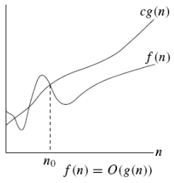

O-notation
Asymptotic upper bound

Slide 25
Example
The running time is O(n²) means there is a function f(n) that is O(n²) such that for any value of n, no matter what particular input of size n is chosen, the running time of that input is bounded from above by the value f(n).
  3 * n² + n/2 + 12 ∈ O(n²)
  4*n*log₂(3*n+1) + 2*n-1 ∈ O(n * log n)

Slide 26
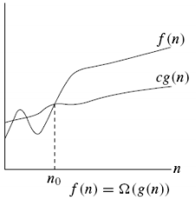

Ω notation
Asymptotic lower bound

Slide 27
Example
When we say that the running time (no modifier) of an algorithm is Ω (g(n)).
we mean that no matter what particular input of size n is chosen for each value of n, the running time on that input is at least a constant times g(n), for sufficiently large n.
  n³ + 20n ∈ Ω(n²)

Slide 28
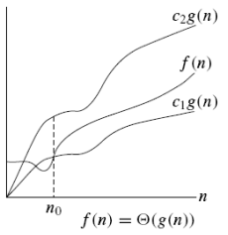

Θ notation
g(n) is an asymptotically tight bound of f(n)

Slide 29

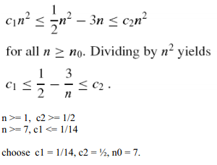
Example

Slide 30
Big O notation
f(n)=O(g(n)) iff there exist a positive constant c and non-negative integer n₀ such that
f(n) ≤ cg(n) for all n≥n0.
g(n) is said to be an upper bound of f(n).

Slide 31
Basic rules
1. Nested loops are multiplied together.
2. Sequential loops are added.
3. Only the largest term is kept, all others are dropped.
4. Constants are dropped.
5. Conditional checks are constant (i.e. 1).

Slide 32
Example of complexity

Slide 33
Linear loop
1)
for(int i = 0; i < 10; i++)
{
cout << i << endl;
}
//time taken = ?

Slide 34
2)
for(int i = 0; i < n; i++)
{
cout << i << endl;
}
//time taken = ?

Slide 35
Ans: O(n)

Slide 36
Quadratic Loops
1) for(int i = 0; i < 100; i++)
{
for(int j = 0; j < 100; j++)
    {
//do swap stuff, constant time
}
} //Time Taken =?

Slide 37
2) for(int i = 0; i < n; i++)
{
for(int j = 0; j < n; j++)
    {
//do swap stuff, constant time
}
} //Time Taken =?

Slide 38
Ans O(n^2)

Slide 39
Complex condition
for(int i = 0; i < 2*100; i++)
{
cout << i << endl;
}
//Time Taken =?

Slide 40
2) for(int i = 0; i < 2*n; i++)
{
cout << i << endl;
}
//Time Taken =?

Slide 41
At first you might say that the upper bound is O(2n); however, we drop constants so it becomes O(n)

Slide 42
More loops in one program
for(int i = 0; i <10 ; i++)
{
cout << i << endl;
}
for(int i = 0; i < 100; i++)
{
for(int j = 0; j < 100; j++)
{
//do constant time stuff
}
} //Time Taken =?

Slide 43
2)
for(int i = 0; i < n; i++)
{
cout << i << endl;
}
for(int i = 0; i < n; i++)
{
for(int j = 0; j < n; j++)
{
//do constant time stuff
}
} //Time Taken =?

Slide 44
Ans : In this case we add each loop's Big O, in this case n+n^2. O(n^2+n) is not an acceptable answer since we must drop the lowest term. The upper bound is O(n^2). Why? Because it has the largest growth rate

Slide 45
Quadratic loop
1) for(int i = 0; i < 100; i++)
{
for(int j = 0; j < 2; j++)
{
//do stuff
}
} //Time Taken =?

Slide 46
2) for(int i = 0; i < n; i++)
{
for(int j = 0; j < 2; j++)
{
//do stuff
}
}
//Time Taken =?

Slide 47
Ans: Outer loop is 'n', inner loop is 2, this we have 2n, dropped constant gives up O(n)

Slide 48
Complex iteration
1) for(int i = 1; i < n; i =i* 2)
{
cout << i << endl;
}
//Time Taken =?

Slide 49
2) for(int i = 1; i < 100; i =i* 2)
{
cout << i << endl;
}
//Time Taken =?

Slide 50
There are n iterations, however, instead of simply incrementing, 'i' is increased by 2*itself each run. Thus the loop is log(n).

Slide 51
Quadratic loop
1) for(int i = 0; i < n; i++)
{
for(int j = 1; j < n; j *= 2)
{
//do constant time stuff
}
}
//Time Taken =?

Slide 52
Ans: n*log(n)

Slide 53
While (n>=1)
{
n=n/2;
}
2) While (n>=1)
{
n=n/2;
}

Slide 54




Comp 122

Slide 55
time space tradeoff
A time space tradeoff is a situation where the memory use can be reduced at the cost of slower program execution (and, conversely, the computation time can be reduced at the cost of increased memory use).
As the relative costs of CPU cycles, RAM space, and hard drive space change—hard drive space has for some time been getting cheaper at a much faster rate than other components of computers[citation needed]—the appropriate choices for time space tradeoff have changed radically.
Often, by exploiting a time space tradeoff, a program can be made to run much faster.

Slide 56
Time Space Trade-off
In computer science, a space-time or time-memory trade off is a situation where the memory use can be reduced at the cost of slower program execution (or, vice versa, the computation time can be reduced at the cost of increased memory use). As the relative costs of CPU cycles, RAM space, and hard drive space change — hard drive space has for some time been getting cheaper at a much faster rate than other components of computers-the appropriate choices for space-time tradeoffs have changed radically. Often, by exploiting a space-time tradeoff, a program can be made to run much faster.

Slide 57
Types of Time Space Trade-off
Lookup tables v. recalculation
The most common situation is an algorithm involving a lookup table: an implementation can include the entire table, which reduces computing time, but increases the amount of memory needed, or it can compute table entries as needed, increasing computing time, but reducing memory requirements.
Compressed v. uncompressed data
A space-time trade off can be applied to the problem of data storage. If data is stored uncompressed, it takes more space but less time than if the data were stored compressed (since compressing the data reduces the amount of space it takes, but it takes time to run the decompression algorithm). Depending on the particular instance of the problem, either way is practical.

Slide 58
Thank You

